Slide 1

Workplace assistant augmented reality
Gabriel Camilleri

Slide 2
Problem Definition

Slide 3

Problem Definition
To build a real-time assisting application which can help interns and visitors easily adjust within a workplace
An application which would address job-fit and job-stress for new employees
To provide an assistant augmented reality application
Choosing the right AR and recommendation techniques for the right context in which they are to be applied in.

Slide 4
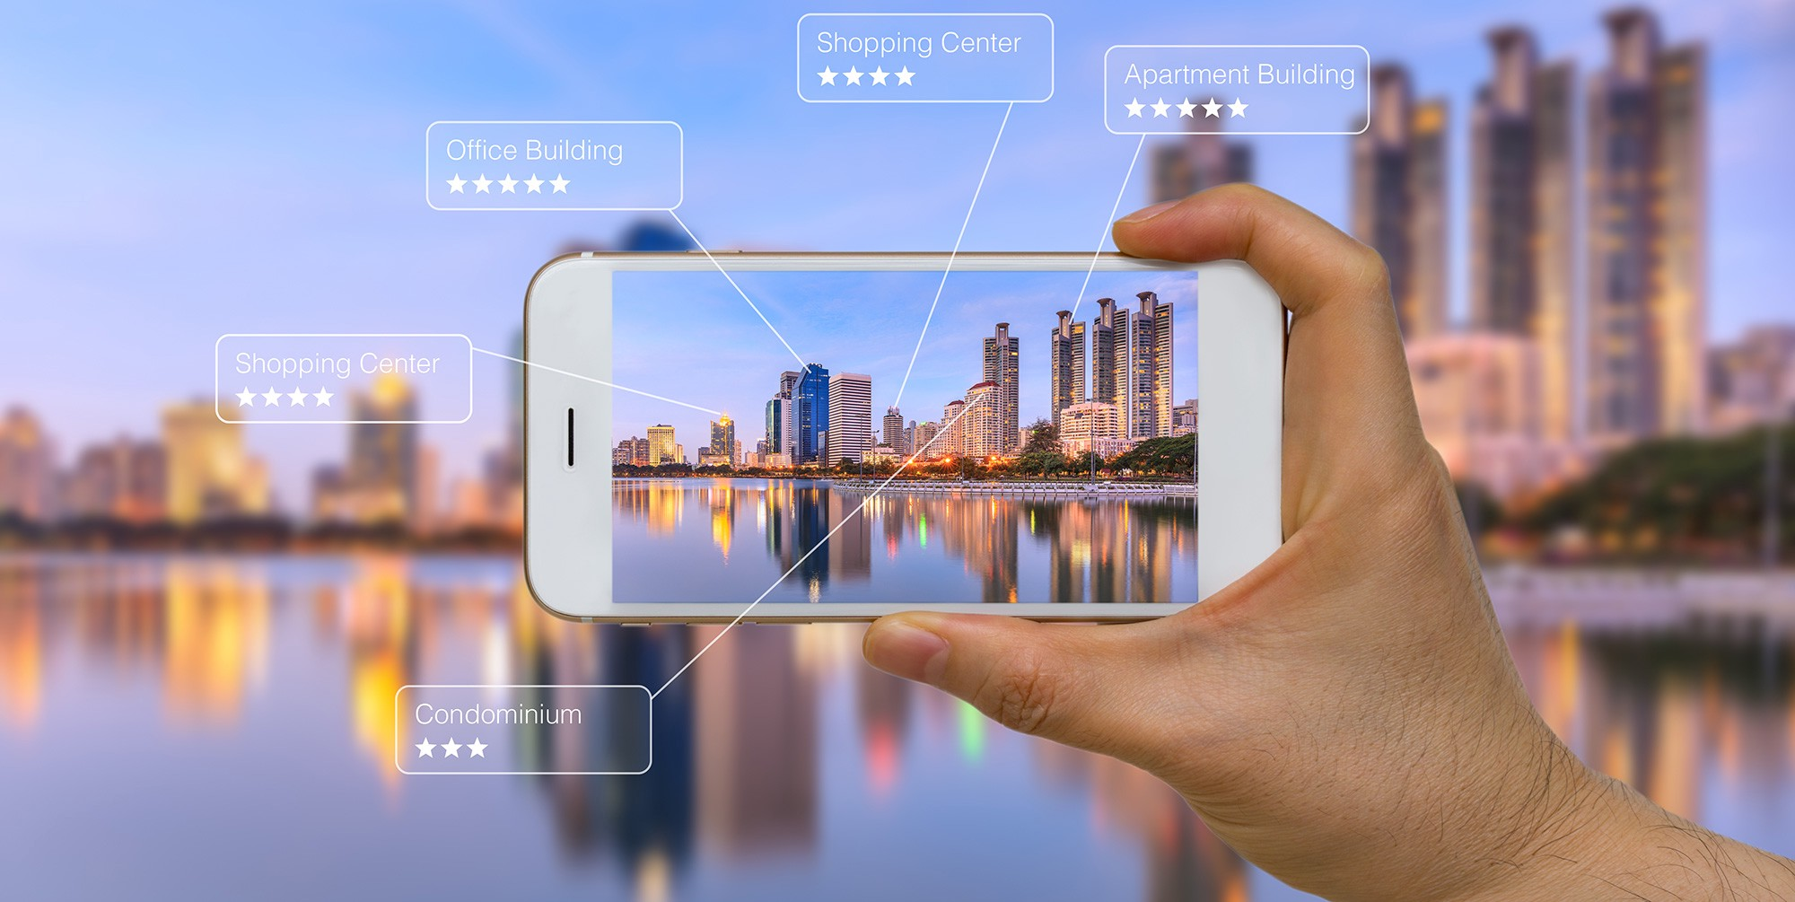
Research Questions
Which is the right Augmented Reality Library for the current context?
What are the right computer vision techniques to apply?
What models and techniques are suitable to implement user recommendation depending on the user’s task at hand?

Slide 5
Background and literature review

Slide 6
Background Research and Literature Review
Workplace AR training normally is provided in two forms:
On the job training
Off the Job training
AR can provide training by overlaying 2D and 3D information in real-time, whilst also providing the users the ability to author the environment around and interact with it.
Vuforia is compatible with more smartphones than ARCore and ARKit, thus having the ability to run not just on the latest smartphones.
Vuforia provides traditional computer vision techniques and deep learning techniques for image and object recognition
Vuforia makes use of pose feature detection, taking into consideration position and orientation of the natural features as well as extended tracking.
Recommendation systems are a valuable tool for AR applications, they can provide relevant augmented information according to the user’s preferences.

Slide 7
Background Research and Literature Review (Cont.)
Collaborative filtering algorithms are commonly used for recommendations.
When applied to the MovieLens dataset SVD++ performed best in comparison to other models.
The problem is when applying these models in AR as AR applications fully depend on:
Location, timing, first use of the app and immediate responses from the application.
Distance based, time based, and visibility based recommendation are common in AR applications.
Augmented Reality makes use of image and object recognition technology
Such technology depends on traditional computer vision techniques and deep learning techniques
Traditional techniques are useful when recognising 2D images and characters due to using edges and contours as natural features to identify
Deep Learning technology is applicable in scenarios where that object may differentiate in its state due to the lighting variances, distance variances, rotation variances, and occlusion variances as the technology is trained on that specific 3D object using different frames capturing different angles, distances and colours in which that object may appear in, thus being capable of generalising.

Slide 8
The 3 Main Components of the System
The user
Augmented Reality
User Recommendation System

Slide 9
Design and Implementation

Slide 10
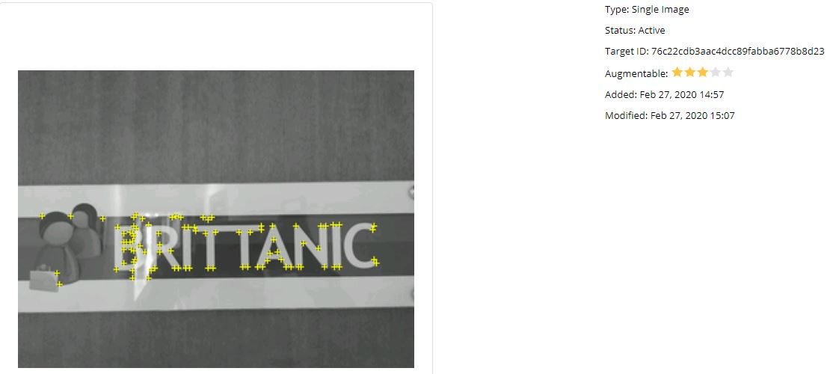
Data Handling
AR component
Images were taken
Initially of corridors
Feature extraction problem
Specific door signs were chosen as markers
Had unique distinct features
3D models were generated (11 in total)
Recommendation Component
A prototype dataset was built from scratch containing user-ratings
3 datasets in total for 3 separate tasks for the Visitors
Visit
Delivery
Interview

Slide 11
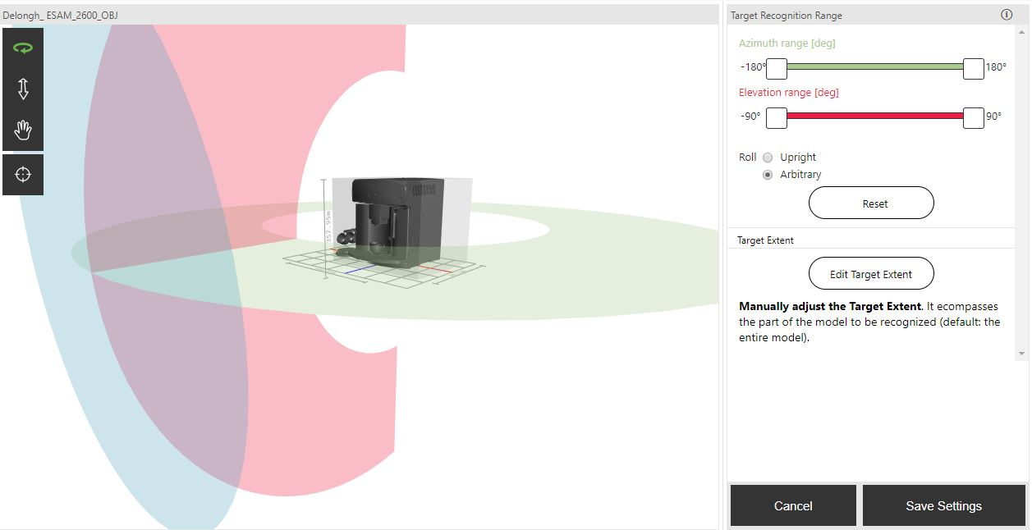
Feature Extraction
Images were fed into Vuforia’s library and were processed using traditional CV techniques.
Detecting edges and contours
3D objects were fed to Vuforia’s model generated to perform deep learning techniques on.
Detecting edges and contours at different lightings, distances, and angles.
Dataset built using different frames of the same object

Slide 12
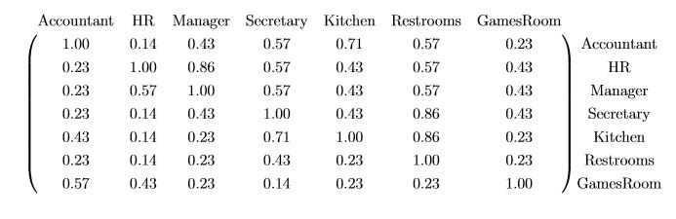
Feature Extraction (Cont)
User Recommendations
Collaborative Filtering
Features, were user ids, task ids and ratings.
Fed to SVD++ model
Matrix Factorisation method
Item-item similarity based matrix
Based on term frequency
Visibility based
Normalised
Based on the amount of times an office (term) is passed by the user while finding an office in particular (document)
Did not apply tf-idf
matrix scaling was done using one-fold normalisation since a term (a location within the office) appears in every task (a task is equivalent to a document)

Slide 13
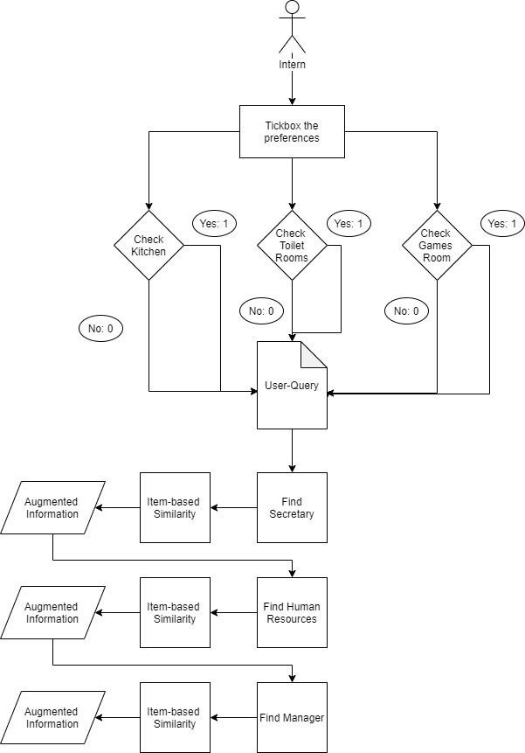
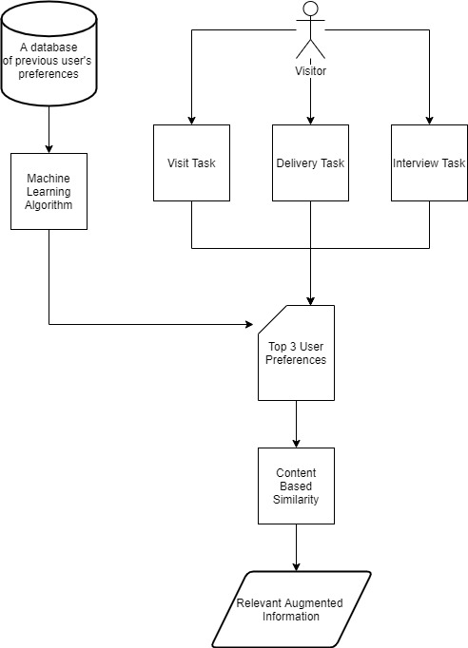
User-Query Models
Intern-Query Model
Visitor-Query Model

Slide 14
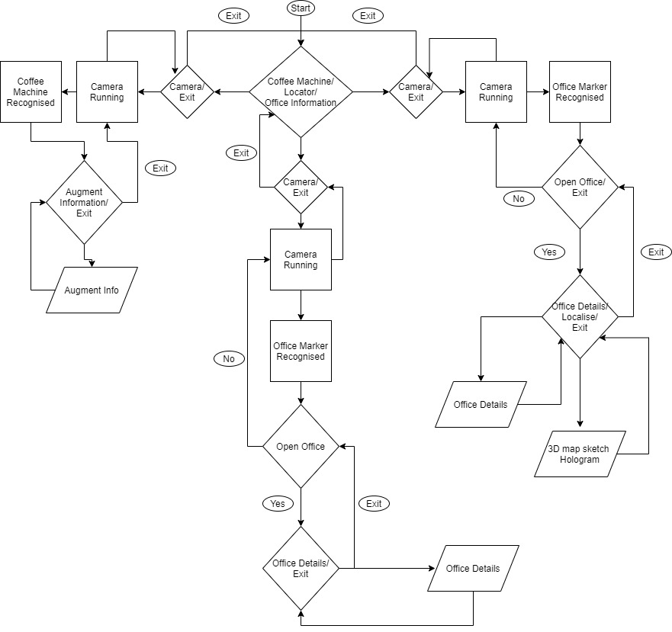
Architecture
Offices Information
(wandering around)
Locator
Intern
Step By step process
Secretary
HR
Manager
Visitor
Profiling on:
Visit
Interview
Delivery
Coffee Machine

Slide 15
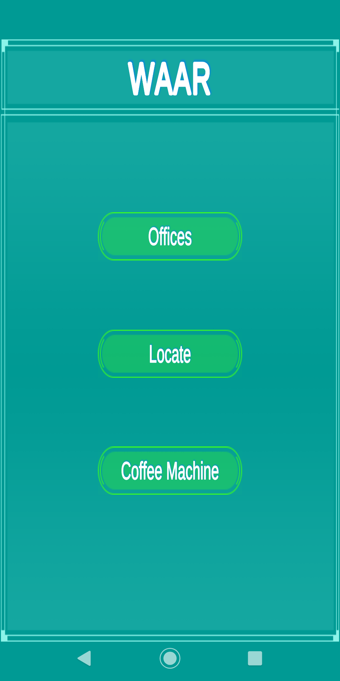
Main Menu

Slide 16
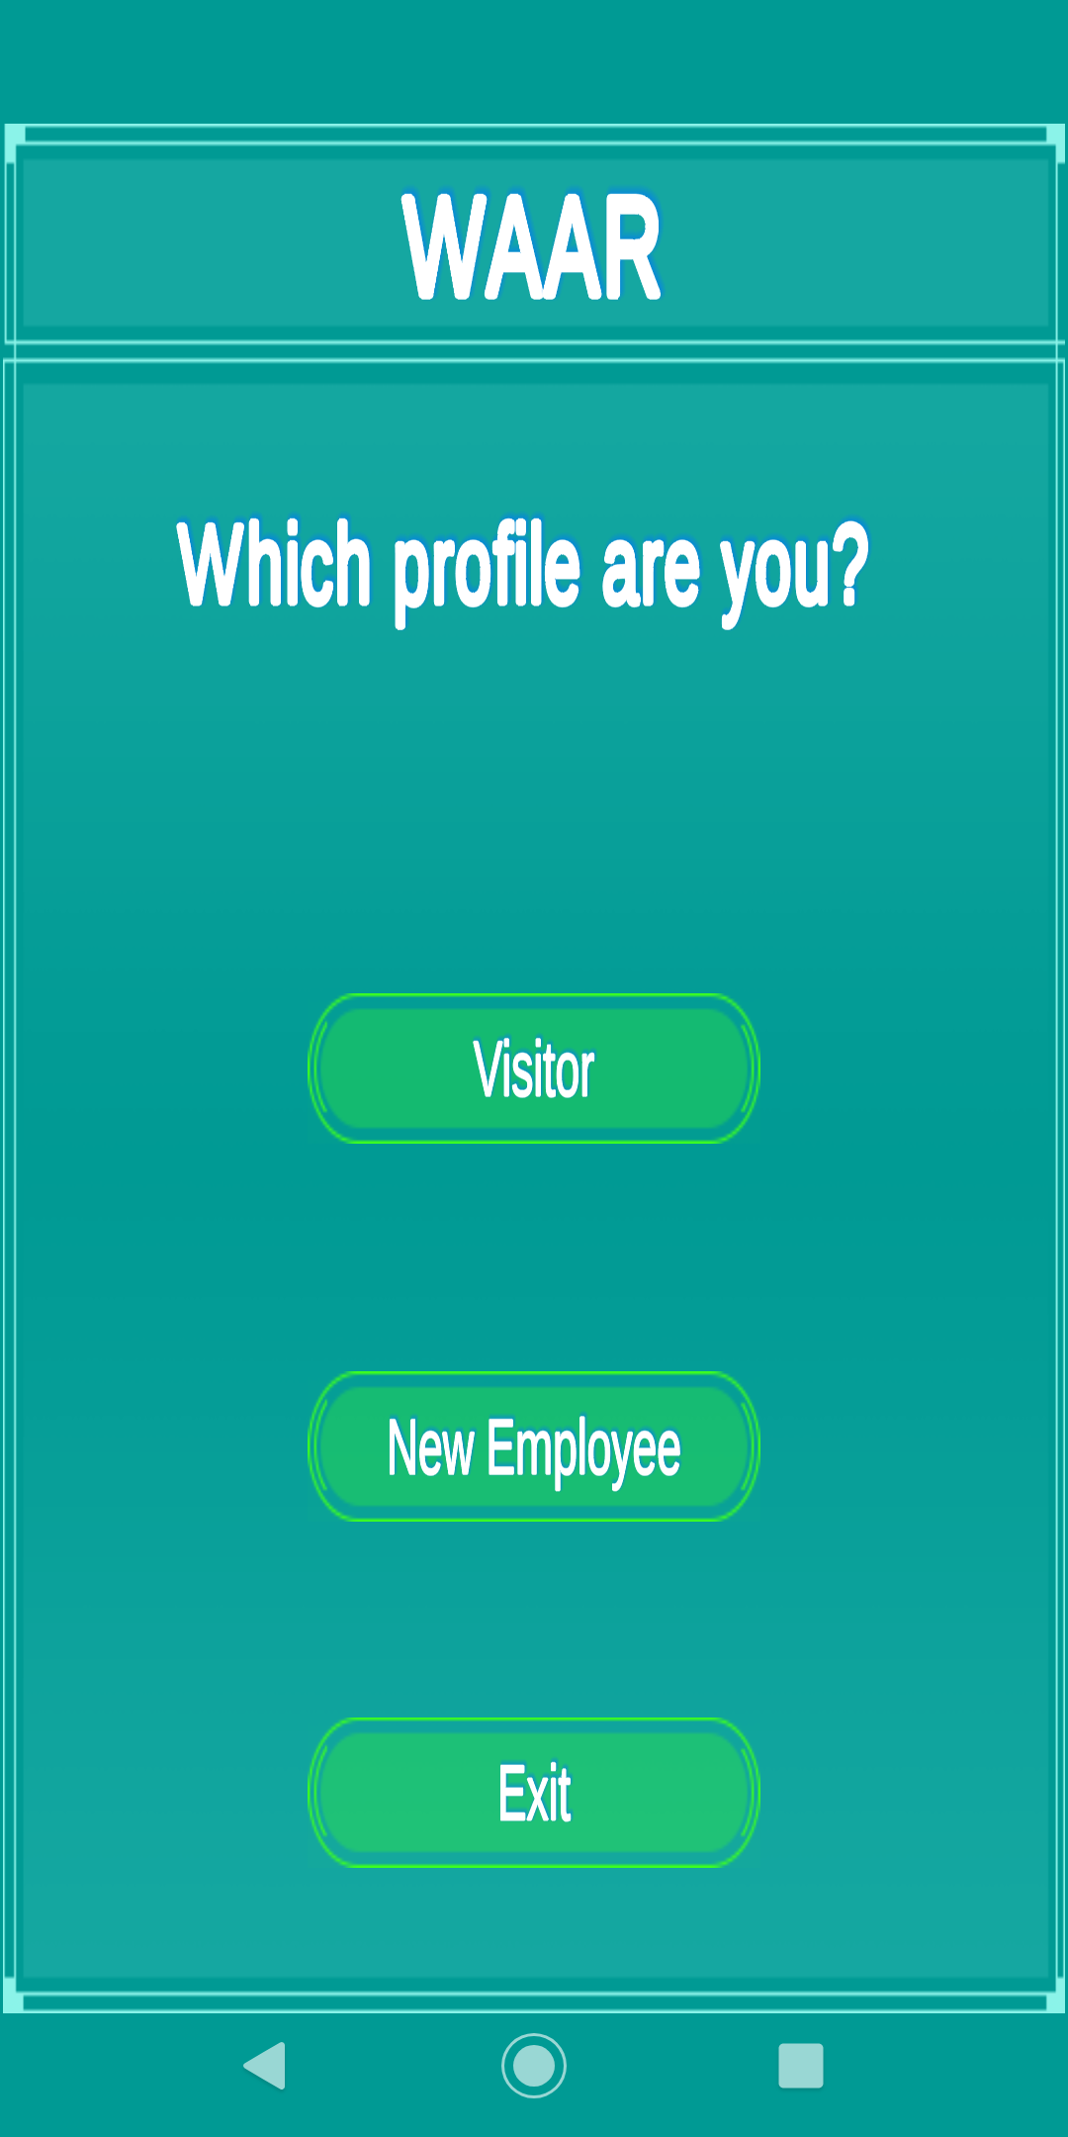
Choosing a user profile

Slide 17
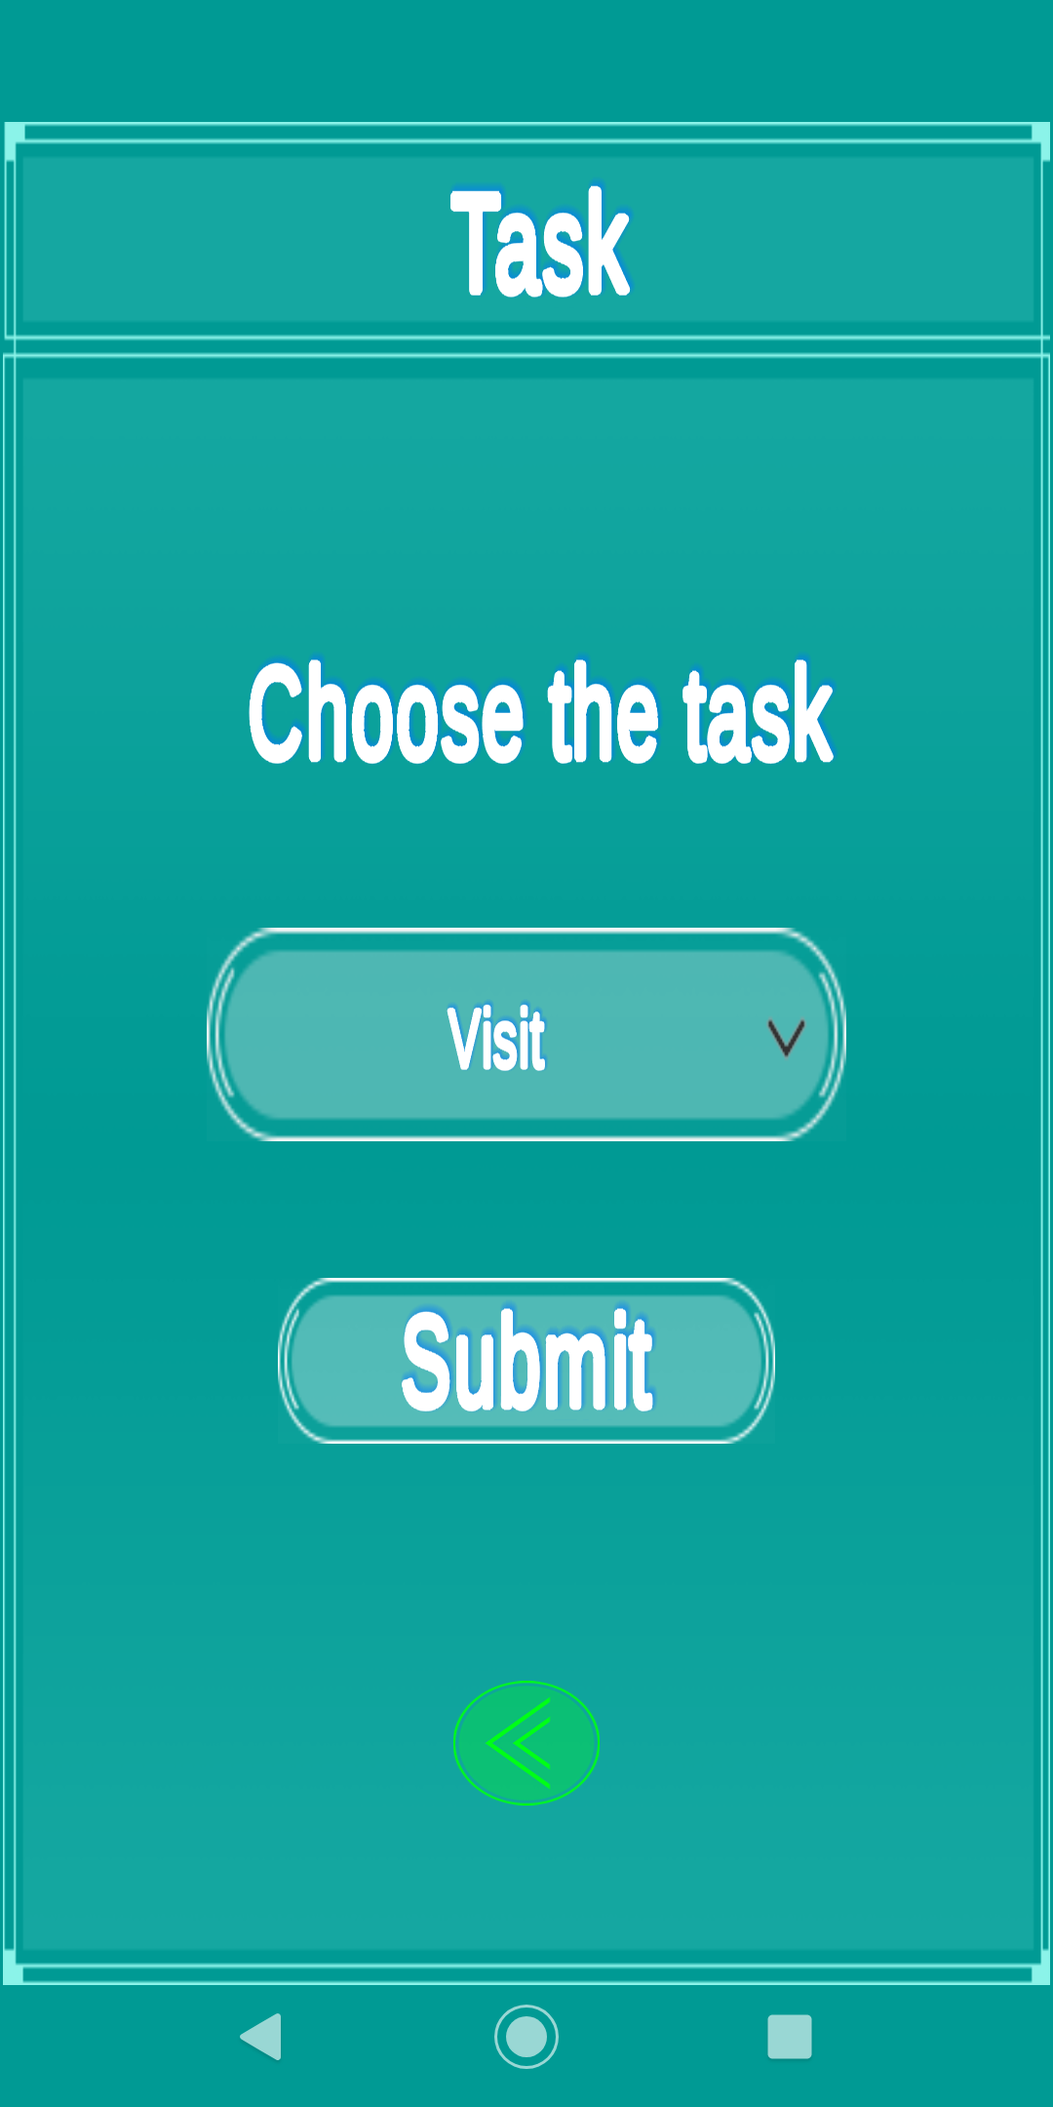
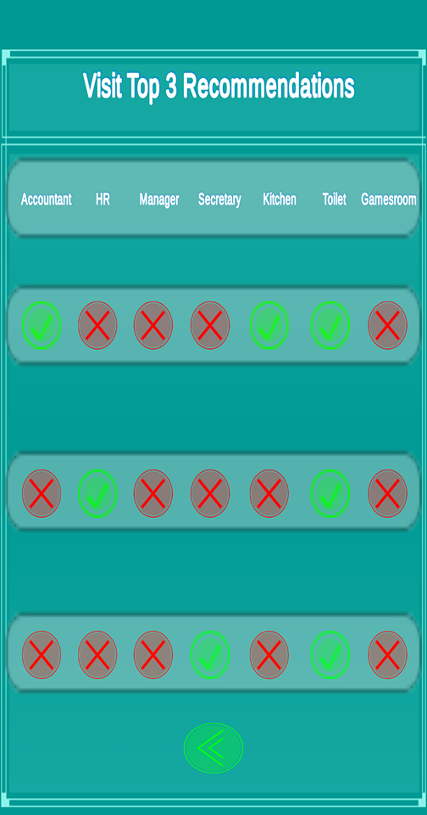
Visitor’s Section

Slide 18
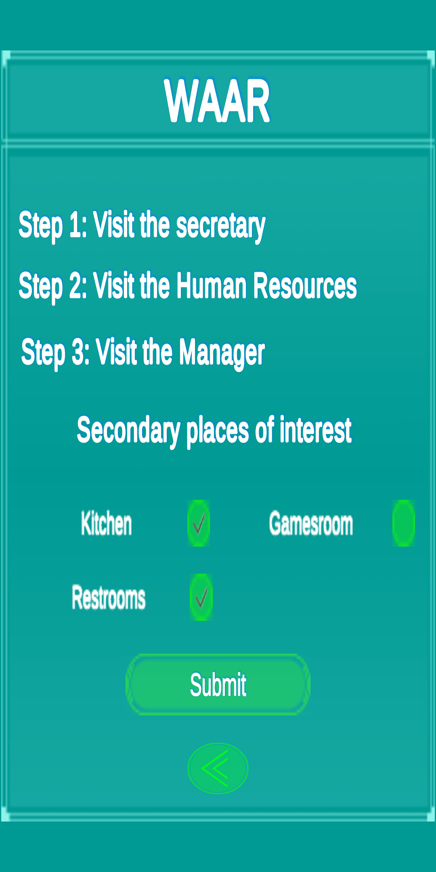
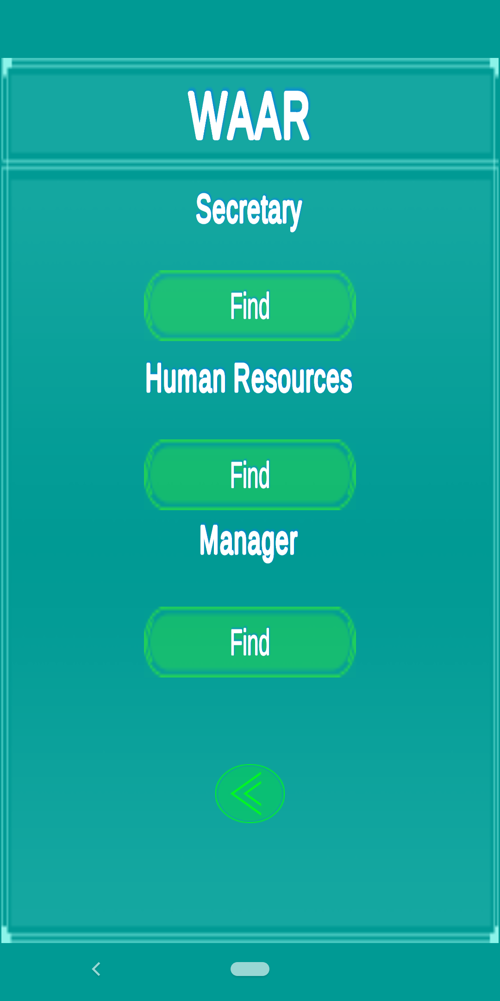
Intern’s Section

Slide 19
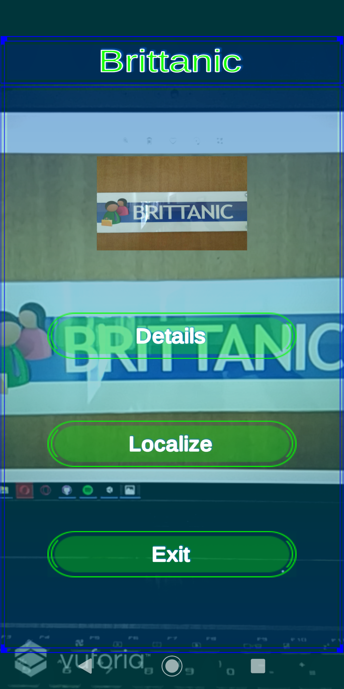
Augmented Reality Offices

Slide 20
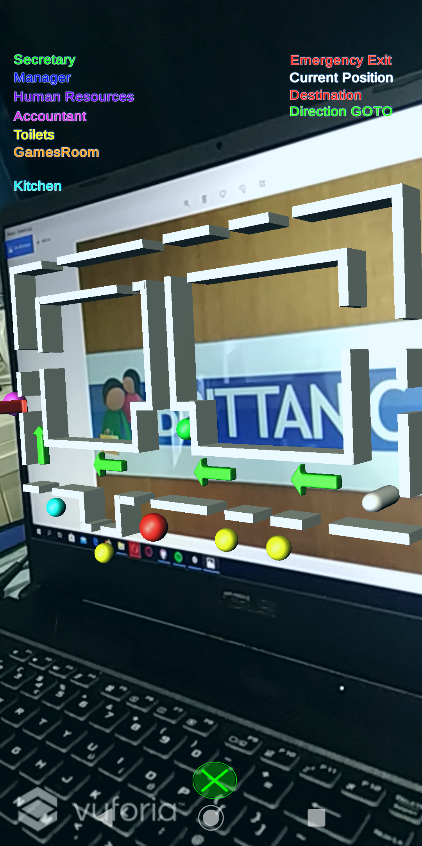
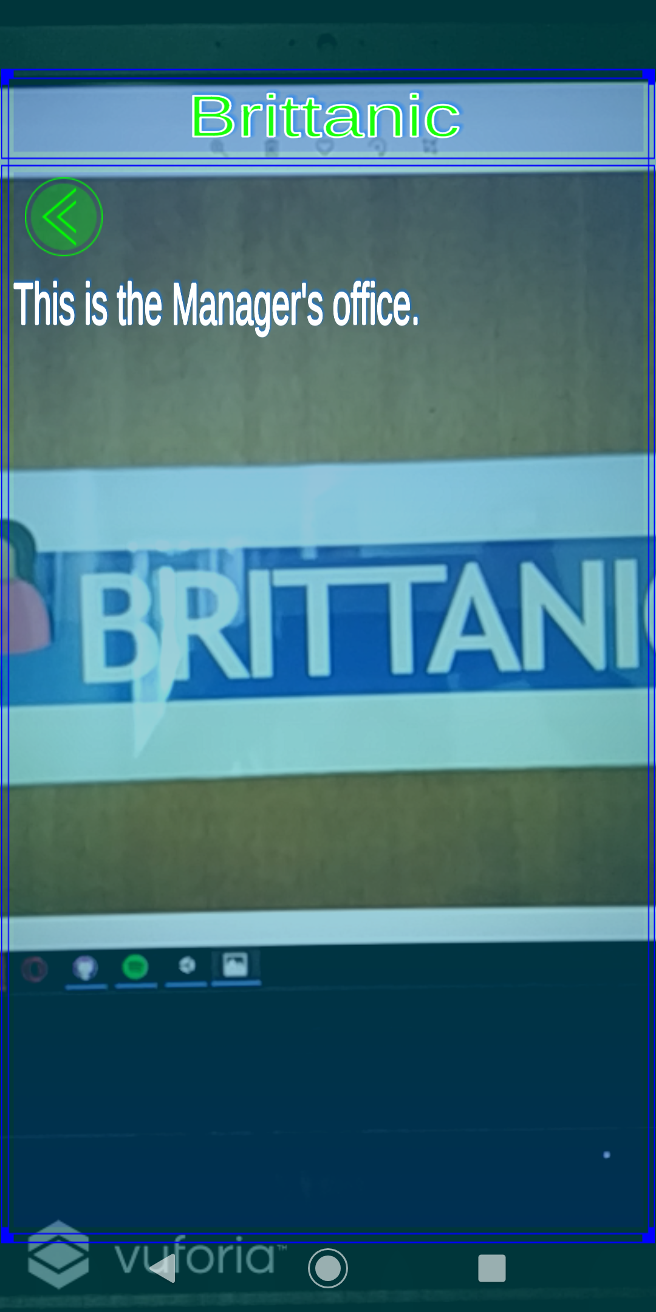
Augmented Reality Offices

Slide 21
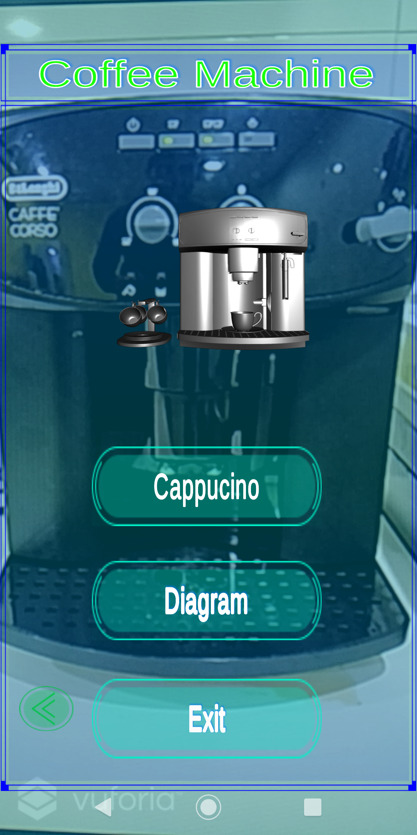
Coffee Machine

Slide 22
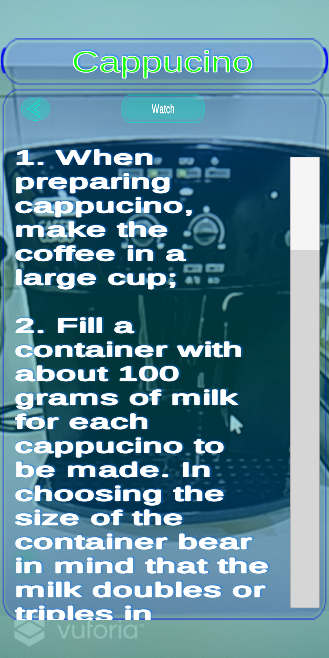
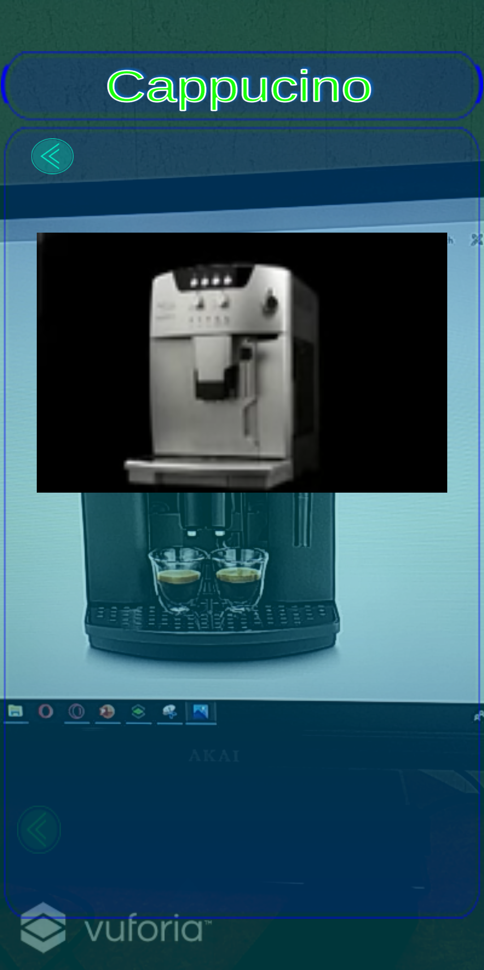
AR Coffee Machine Cappuccino Details

Slide 23
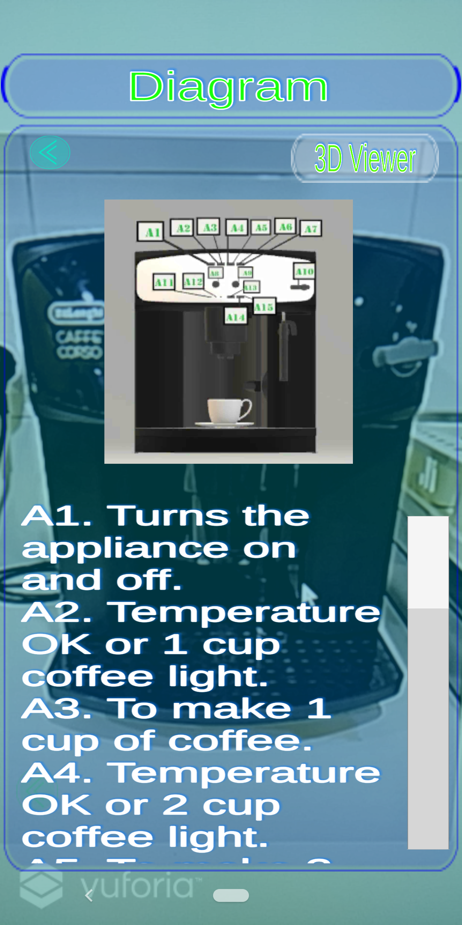
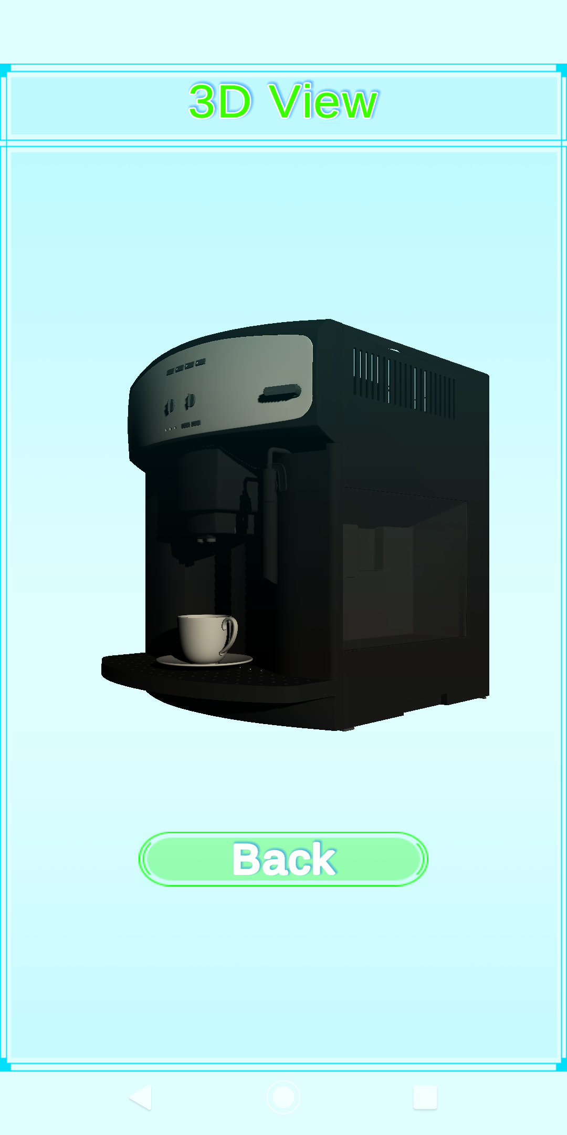
AR Coffee Machine Cappuccino Details

